Slide 1
Tuesday, August 30, 2016
Write In Your Agenda:
Write In Your Monitoring Log:
CW:
Falling Through the Earth writing activity
HW:
Study for quiz on Friday 9/2
Response to Warm-Up:
What do you think it would feel like to fall through the layers of the Earth?
You will need:
Pencil
Layers of the Earth handouts and notes

Slide 2
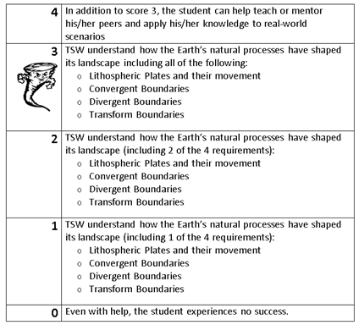
Learning Goal and Scale
TSW understand how the Earth’s natural processes have shaped its landscape (including Lithospheric Plates and their movement, Convergent, Divergent, and Transform boundary landforms).

